Slide 1

Introduce about Version Control System

Slide 2
What is Version Control System (VCS)?
Version control is a system that records changes to a file or set of files over time so that you can recall specific versions later.
It allows you to revert files back to a previous state, revert the entire project back to a previous state, compare changes over time, see who last modified something that might be causing a problem, who introduced an issue and when, and more.
Using a VCS also generally means that if you screw things up or lose files, you can easily recover. In addition, you get all this for very little overhead.

Slide 3

Local Version Control Systems
VCSs that had a simple database that kept all the changes to files under revision control (ex: RCS)

Slide 4
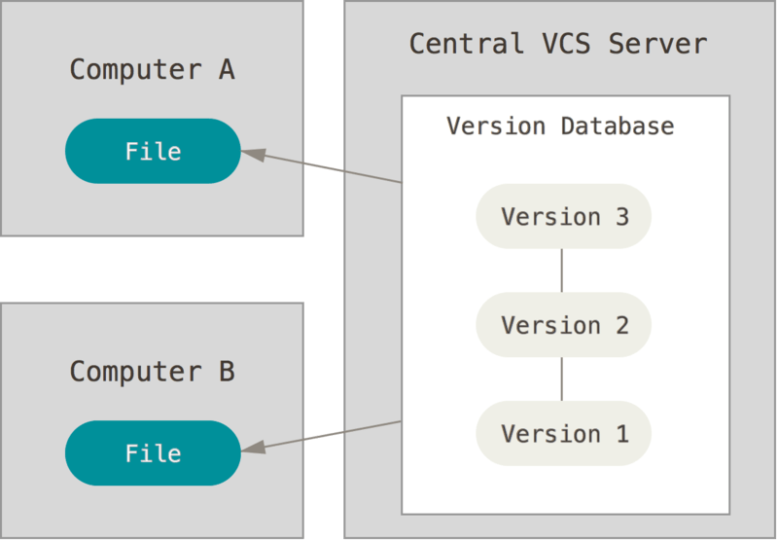
Centralized Version Control Systems
Example: SVN

Slide 5
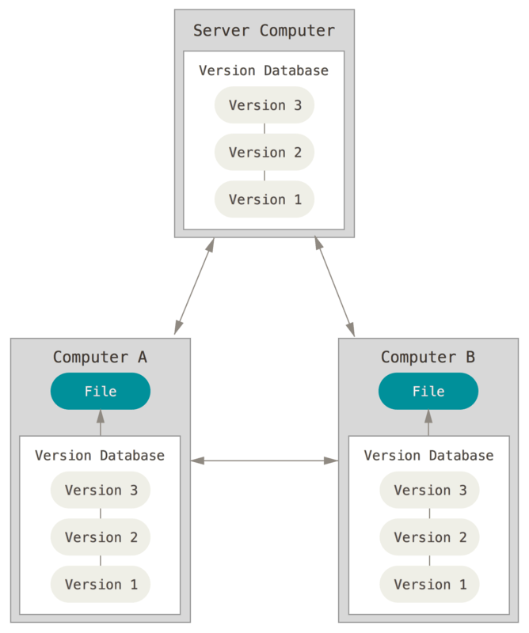
Distributed Version Control Systems
Such as Git, Mercurial, Bazaar or Darcs
Clients don’t just check out the latest snapshot of the files: they fully mirror the repository
Thus if any server dies, and these systems were collaborating via it, any of the client repositories can be copied back up to the server to restore it.

Slide 6
Introduce about GIT

Slide 7
A Short History of Git
In 2002, the Linux kernel project began using a proprietary DVCS called BitKeeper.
In 2005, the relationship between the community that developed the Linux kernel and the commercial company that developed BitKeeper broke down
This prompted the Linux development community to develop their own tool based on some of the lessons they learned while using BitKeeper.
Some of the goals of the new system were as follows:
Speed
Simple design
Strong support for non-linear development (thousands of parallel branches)
Fully distributed
Able to handle large projects like the Linux kernel efficiently (speed and data size)

Slide 8
Git Basics
Snapshots, Not Differences
Nearly Every Operation Is Local
Git Has Integrity
Git Generally Only Adds Data
The Three States

Slide 9
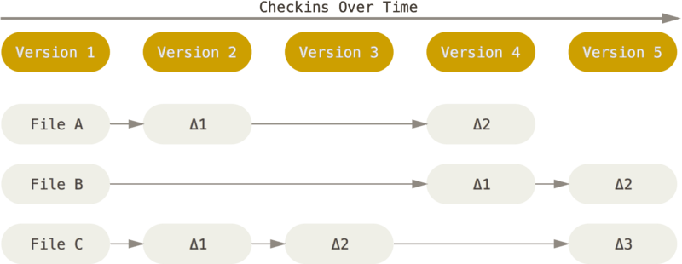
Snapshots, Not Differences
The major difference between Git and any other VCS (Subversion and friends included) is the way Git thinks about its data.
Most other systems store information as a list of file-based changes. These systems (CVS, Subversion, Perforce, Bazaar, and so on) think of the information they keep as a set of files and the changes made to each file over time.

Slide 10
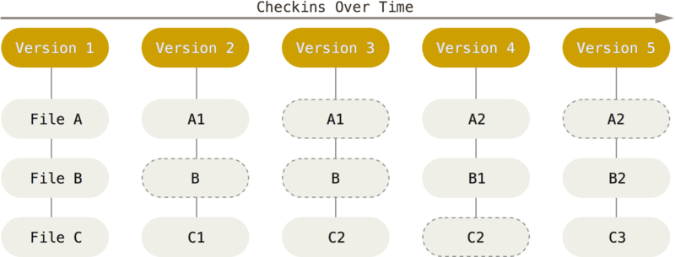
Snapshots, Not Differences - 2
Git thinks of its data more like a set of snapshots of a miniature filesystem.
This is an important distinction between Git and nearly all other VCSs.

Slide 11
Nearly Every Operation Is Local
Most operations in Git only need local files and resources to operate – generally no information is needed from another computer on your network.
Because you have the entire history of the project right there on your local disk, most operations seem almost instantaneous.

Slide 12
Git Has Integrity
Everything in Git is check-summed before it is stored and is then referred to by that checksum.
This means it’s impossible to change the contents of any file or directory without Git knowing about it.
You can’t lose information in transit or get file corruption without Git being able to detect it.
The mechanism that Git uses for this checksumming is called a SHA-1 hash. This is a 40-character string composed of hexadecimal characters (0–9 and a–f) and calculated based on the contents of a file or directory structure in Git.

Slide 13
Git Generally Only Adds Data
When you do actions in Git, nearly all of them only add data to the Git database
After you commit a snapshot into Git, it is very difficult to lose, especially if you regularly push your database to another repository.

Slide 14
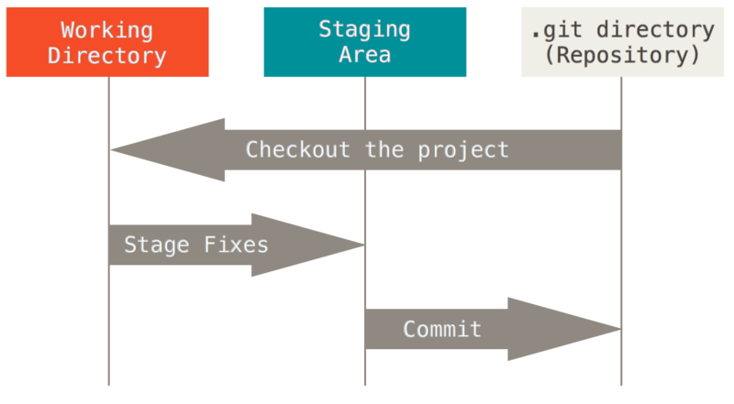
The Three States
This is the main thing to remember about Git if you want the rest of your learning process to go smoothly.
Git has three main states that your files can reside in: committed, modified, and staged.

Slide 15
The Three States - 2
The Git directory is where Git stores the metadata and object database for your project. This is the most important part of Git, and it is what is copied when you clone a repository from another computer.
The working directory is a single checkout of one version of the project. These files are pulled out of the compressed database in the Git directory and placed on disk for you to use or modify.
The staging area is a file, generally contained in your Git directory, that stores information about what will go into your next commit. It’s sometimes referred to as the “index”, but it’s also common to refer to it as the staging area.
The basic Git workflow goes something like this:
You modify files in your working directory.
You stage the files, adding snapshots of them to your staging area.
You do a commit, which takes the files as they are in the staging area and stores that snapshot permanently to your Git directory.

Slide 16
Download and Installing
Download
Linux: http://git-scm.com/download/mac
Mac: http://git-scm.com/download/mac
Windows: http://git-scm.com/download/win
Installing
Test with some commands

Slide 17
Git Setup
Git comes with a tool called git config that lets you get and set configuration variables that control all aspects of how Git looks and operates.
/etc/gitconfig file: Contains values for every user on the system and all their repositories. If you pass the option --system to git config, it reads and writes from this file specifically.
~/.gitconfig or ~/.config/git/config file: Specific to your user. You can make Git read and write to this file specifically by passing the --global option.
config file in the Git directory (that is, .git/config) of whatever repository you’re currently using: Specific to that single repository.

Slide 18
Your Identity
The first thing you should do when you install Git is to set your user name and email address.
This is important because every Git commit uses this information, and it’s immutably baked into the commits you start creating:
$ git config --global user.name "John Doe"
$ git config --global user.email johndoe@example.com

Slide 19
Your Editor
Now that your identity is set up, you can configure the default text editor that will be used when Git needs you to type in a message.
If not configured, Git uses your system’s default editor.
Example Notepad++:
x86: git config --global core.editor "'C:/Program Files/Notepad++/notepad++.exe' -multiInst -nosession“
x64: git config --global core.editor "'C:/Program Files (x86)/Notepad++/notepad++.exe' -multiInst -nosession"

Slide 20
Checking Your Settings
If you want to check your settings, you can use the git config --list command to list all the settings
git config --list
You may see keys more than once, because Git reads the same key from different files
You can also check what Git thinks a specific key’s value is by typing:
git config user.name

Slide 21
Getting Helps
If you ever need help while using Git, there are three ways to get the manual page (manpage) help for any of the Git commands:
$ git help <verb>
$ git <verb> --help
$ man git-<verb>

Slide 22
Initializing a Repository in an Existing Directory
If you’re starting to track an existing project in Git, you need to go to the project’s directory and type:
$ git init
This creates a new subdirectory named .git that contains all of your necessary repository files – a Git repository skeleton.
If you want to start version-controlling existing files (as opposed to an empty directory), you should probably begin tracking those files and do an initial commit.
$ git add *.c
$ git add LICENSE
$ git commit -m 'initial project version'

Slide 23
Cloning an Existing Repository
If you want to get a copy of an existing Git repository – for example, a project you’d like to contribute to – the command you need is git clone.
Syntax: git clone [url]
Example: $ git clone https://github.com/teduinternational/tedushop.git
Clone with specify folder name: $ git clone https://github.com/teduinternational/tedushop.git tedushop
Git has a number of different transfer protocols you can use. You also can use SSH:
Example: $ git clone git@github.com:teduinternational/tedushop.git

Slide 24
Recording Changes to the Repository

Slide 25
Content
Checking the Status of Your Files
Tracking New Files
Staging Modified Files
Short Status
Ignoring Files
Viewing Your Staged and Unstaged Changes
Committing Your Changes
Skipping the Staging Area
Removing Files
Moving Files

Slide 26
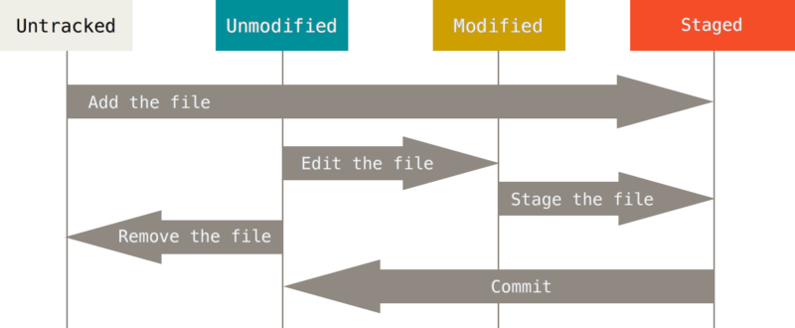
The lifecycle of the status of your files.

Slide 27
Checking the Status of Your Files
$ git status: Checking this current working directory status
$ git add README: In order to begin tracking a new file, you use the command
While the git status output is pretty comprehensive, it’s also quite wordy.
Git also has a short status flag so you can see your changes in a more compact way.
$git status –s or $git status --short

Slide 28
Tracking New Files
In order to begin tracking a new file, you use the command git add. To begin tracking the README file, you can run this:
$ git add README

Slide 29
Staging Modified Files
$ git add CONTRIBUTING.md
$ git status
To stage it, you run the git add command. git add is a multipurpose command – you use it to begin tracking new files, to stage files, and to do other things like marking merge-conflicted files as resolved.
It may be helpful to think of it more as “add this content to the next commit” rather than “add this file to the project”.

Slide 30
Ignoring Files
Git ignore file has name .gitignore
It has been used for exclude all files and folders or whatever you want from your repository.
You can use some rules for define content this file.
You should define it before any commit.
If you define after, you should delete some unwanted on repository.
Github provive all gitignore sample file for every tools at: https://github.com/github/gitignore

Slide 31
Viewing Your Staged and Unstaged Changes
$git diff command is too vague for you – you want to know exactly what you changed, not just which files were changed.
$git diff shows you the exact lines added and removed – the patch.
$git diff --staged command you want to see what you’ve staged that will go into your next commit

Slide 32
Committing Your Changes
Now that your staging area is set up the way you want it, you can commit your changes.
Remember that anything that is still unstaged – any files you have created or modified that you haven’t run git add on since you edited them – won’t go into this commit.
The simplest way to commit is to type git commit
Doing so launches your editor of choice you can configure it with whatever you want using the $git config --global core.editor command
Or commit with inline message: $git commit -m “Message"

Slide 33
Skipping the Staging Area
Adding the -a option to the git commit command makes Git automatically stage every file that is already tracked before doing the commit
$ git commit -a -m 'added new benchmarks‘
Notice how you don’t have to run git add on the CONTRIBUTING.md file in this case before you commit. That’s because the -a flag includes all changed files.
This is convenient, but be careful; sometimes this flag will cause you to include unwanted changes.

Slide 34
Removing Files
$git rm: To remove a file from Git, you have to remove it from your tracked files (more accurately, remove it from your staging area) and then commit.
$ git rm --cached README: ou may want to keep the file on your hard drive but not have Git track it anymore
$ git rm log/\*.log: You can pass files, directories, and file-glob patterns to the git rm command

Slide 35
Moving Files
If you want to rename a file in Git, you can run something like:
$ git mv file_from file_to
Git figures out that it’s a rename implicitly, so it doesn’t matter if you rename a file that way or with the mv command

Slide 36
Viewing the Commit History

Slide 37
Viewing the Commit History
The most basic and powerful tool to do this is the $git log command.
A huge number and variety of options to the git log command are available to show you exactly what you’re looking for. Here, we’ll show you some of the most popular.

Slide 38
Viewing the Commit History
One of the more helpful options is -p, which shows the difference introduced in each commit.
You can also use -2, which limits the output to only the last two entries
$ git log -p -2

Slide 39
Undo things

Slide 40
Contents
Undoing Things
Unstaging a Staged File
Unmodifying a Modified File

Slide 41
Recap

Slide 42
Undoing Things
One of the common undos takes place when you commit too early and possibly forget to add some files, or you mess up your commit message. If you want to try that commit again, you can run commit with the --amend option:
$ git commit –amend
As an example, if you commit and then realize you forgot to stage the changes in a file you wanted to add to this commit, you can do something like this. You end up with a single commit – the second commit replaces the results of the first.
$ git commit -m 'initial commit'
$ git add forgotten_file
$ git commit --amend

Slide 43
Unstaging a Staged File
Let’s say you’ve changed two files and want to commit them as two separate changes, but you accidentally type git add * and stage them both.
How can you unstage one of the two?
$ git add *
$ git status
To unstaged a file:
$ git reset HEAD CONTRIBUTING.md

Slide 44
Unmodifying a Modified File
What if you realize that you don’t want to keep your changes to the CONTRIBUTING.md file? How can you easily unmodify it – revert it back to what it looked like when you last committed.
$ git checkout -- CONTRIBUTING.md
It’s important to understand that git checkout -- <file> is a dangerous command. Any changes you made to that file are gone – Git just copied another file over it.
Don’t ever use this command unless you absolutely know that you don’t want the file.
Remember, anything that is committed in Git can almost always be recovered. Even commits that were on branches that were deleted or commits that were overwritten with an --amend commit can be recovered

Slide 45
Working with Remotes

Slide 46
Content
Overview
Showing Your Remotes
Adding Remote Repositories
Fetching and Pulling from Your Remotes
Pushing to Your Remotes
Inspecting a Remote
Removing and Renaming Remotes

Slide 47
Overview
To be able to collaborate on any Git project, you need to know how to manage your remote repositories.
Remote repositories are versions of your project that are hosted on the Internet or network somewhere.
Collaborating with others involves managing these remote repositories and pushing and pulling data to and from them when you need to share work.
Managing remote repositories includes knowing how to add remote repositories, remove remotes that are no longer valid, manage various remote branches and define them as being tracked or not, and more

Slide 48
Showing Your Remotes
To see which remote servers you have configured, you can run the git remote command.
It lists the short names of each remote handle you’ve specified.
If you’ve cloned your repository, you should at least see origin – that is the default name Git gives to the server you cloned from.
$ git clone https://github.com/teduinternational/git.git
$ cd git
$ git remote
You can also specify -v, which shows you the URLs that Git has stored for the shortname to be used when reading and writing to that remote
$ git remote -v

Slide 49
Adding Remote Repositories
We’ve mentioned and given some demonstrations of how the clone command implicitly adds the origin remote for you.
To add a new remote Git repository as a shortname you can reference easily, run:
$git remote add <shortname> <url>
Ex: $git remote add tedu https://github.com/teduinternational/git.git

Slide 50
Fetching and Pulling from Your Remotes
The command goes out to that remote project and pulls down all the data from that remote project that you don’t have yet.
$ git fetch [remote-name]
It’s important to note that the git fetch command only downloads the data to your local repository – it doesn’t automatically merge it with any of your work or modify what you’re currently working on.
You can use the $git pull command to automatically fetch and then merge that remote branch into your current branch.
Running git pull generally fetches data from the server you originally cloned from and automatically tries to merge it into the code you’re currently working on.

Slide 51
Pushing to Your Remotes
When you have your project at a point that you want to share, you have to push it upstream. The command for this is simple: $git push [remote-name] [branch-name]
$ git push tedu master
This command works only if you cloned from a server to which you have write access and if nobody has pushed in the meantime.
If you and someone else clone at the same time and they push upstream and then you push upstream, your push will rightly be rejected.
You’ll have to fetch their work first and incorporate it into yours before you’ll be allowed to push.

Slide 52
Inspecting a Remote
If you want to see more information about a particular remote, you can use the $git remote show [remote-name] command.
$ git remote show origin

Slide 53
Removing and Renaming Remotes
You can run git remote rename to change a remote’s shortname. For instance, if you want to rename pb to paul, you can do so with git remote rename:
$ git remote rename origin tedugit
$ git remote
If you want to remove a remote for some reason – you’ve moved the server or are no longer using a particular mirror, or perhaps a contributor isn’t contributing anymore – you can use git remote rm:
$ git remote rm tedugit
$ git remote

Slide 54
Viewing the Commit History
If you want to see some abbreviated stats for each commit, you can use the --stat option
$ git log –stat
The --stat option prints below each commit entry a list of modified files, how many files were changed, and how many lines in those files were added and removed.
It also puts a summary of the information at the end.

Slide 55
Viewing the Commit History
Another really useful option is --pretty. This option changes the log output to formats other than the default.
The oneline option prints each commit on a single line, which is useful if you’re looking at a lot of commits
$ git log --pretty=oneline

Slide 56
Viewing the Commit History
The most interesting option is format, which allows you to specify your own log output format
$ git log --pretty=format:"%h - %an, %ar : %s"
Option | Description of Output
%H | Commit hash
%h | Abbreviated commit hash
%T | Tree hash
%t | Abbreviated tree hash
%P | Parent hashes
%p | Abbreviated parent hashes
%an | Author name
%ae | Author email
%ad | Author date (format respects the --date=option)
%ar | Author date, relative
%cn | Committer name
%ce | Committer email
%cd | Committer date
%cr | Committer date, relative
%s | Subject

Slide 57
Viewing the Commit History
The oneline and format options are particularly useful with another log option called --graph. This option adds a nice little ASCII graph showing your branch and merge history:
$ git log --pretty=format:"%h %s" --graph
Option | Description
-p | Show the patch introduced with each commit.
--stat | Show statistics for files modified in each commit.
--shortstat | Display only the changed/insertions/deletions line from the --stat command.
--name-only | Show the list of files modified after the commit information.
--name-status | Show the list of files affected with added/modified/deleted information as well.
--abbrev-commit | Show only the first few characters of the SHA-1 checksum instead of all 40.
--relative-date | Display the date in a relative format (for example, “2 weeks ago”) instead of using the full date format.
--graph | Display an ASCII graph of the branch and merge history beside the log output.
--pretty | Show commits in an alternate format. Options include oneline, short, full, fuller, and format (where you specify your own format).

Slide 58
Limiting Log Output
The time-limiting options such as --since and --until are very useful. For example, this command gets the list of commits made in the last two weeks:
$ git log --since=2.weeks
$ git log --pretty="%h - %s" --author=gitster --since="2008-10-01" \
Option | Description
-(n) | Show only the last n commits
--since, --after | Limit the commits to those made after the specified date.
--until, --before | Limit the commits to those made before the specified date.
--author | Only show commits in which the author entry matches the specified string.
--committer | Only show commits in which the committer entry matches the specified string.
--grep | Only show commits with a commit message containing the string
-S | Only show commits adding or removing code matching the string

Slide 59
Tagging

Slide 60
Overview
Tagging
Listing Your Tags
Creating Tags
Annotated Tags
Lightweight Tags
Tagging Later
Sharing Tags
Checking out Tags
Delete tag

Slide 61
Tagging
Like most VCSs, Git has the ability to tag specific points in history as being important.
Typically people use this functionality to mark release points (v1.0, and so on).
In this lesson, you’ll learn how to list the available tags, how to create new tags, and what the different types of tags are.

Slide 62
Listing Your Tags
Listing the available tags in Git is straightforward. Just type git tag:
$git tag
You can also search for tags with a particular pattern. The Git source repo, for instance, contains more than 500 tags. If you’re only interested in looking at the 1.8.5 series, you can run this:
$ git tag -l "v1.8.5*"

Slide 63
Creating Tags
Git uses two main types of tags: lightweight and annotated.
A lightweight tag is very much like a branch that doesn’t change – it’s just a pointer to a specific commit.
Annotated tags, however, are stored as full objects in the Git database.
It’s generally recommended that you create annotated tags so you can have all this information; but if you want a temporary tag or for some reason don’t want to keep the other information, lightweight tags are available too.

Slide 64
Annotated Tags
Creating an annotated tag in Git is simple. The easiest way is to specify -a when you run the tag command:
$ git tag -a v1.4 -m "my version 1.4"
$ git tag
You can see the tag data along with the commit that was tagged by using the git show command:
$ git show v1.4

Slide 65
Lightweight Tags
Another way to tag commits is with a lightweight tag. This is basically the commit checksum stored in a file – no other information is kept.
To create a lightweight tag, don’t supply the -a, -s, or -m option:
$ git tag v1.4-lw
$ git tag

Slide 66
Tagging Later
You can also tag commits after you’ve moved past them. Suppose your commit history looks like this:
$ git log --pretty=oneline
To tag that commit, you specify the commit checksum (or part of it) at the end of the command:
$ git tag -a v1.2 9fceb02

Slide 67
Sharing Tags
By default, the git push command doesn’t transfer tags to remote servers.
You will have to explicitly push tags to a shared server after you have created them.
This process is just like sharing remote branches – you can run
$git push origin [tagname].
Ex: $ git push origin v1.5
If you have a lot of tags that you want to push up at once, you can also use the --tags option to the git push command
$ git push origin --tags

Slide 68
Checking out Tags
You can’t really check out a tag in Git, since they can’t be moved around. If you want to put a version of your repository in your working directory that looks like a specific tag, you can create a new branch at a specific tag with git checkout -b [branchname] [tagname]:
$ git checkout -b version2 v2.0.0

Slide 69
Deleting tag
Delete tag on local:
$ git tag -d {tag_name}
Delete tag on server:
$ git push {remote_name} --delete {tag_name}

Slide 70
Git Branches

Slide 71
Git Branching
Branching means you diverge from the main line of development and continue to do work without messing with that main line.
Nearly every VCS has some form of branching support.
Understanding and mastering this feature gives you a powerful and unique tool and can entirely change the way that you develop.

Slide 72
Git Branching
To really understand the way Git does branching, we need to take a step back and examine how Git stores its data.
Git doesn’t store data as a series of changesets or differences, but instead as a series of snapshots.
When you make a commit, Git stores a commit object that contains a pointer to the snapshot of the content you staged
This object also contains the author’s name and email, the message that you typed, and pointers to the commit or commits that directly came before this commit (its parent or parents): zero parents for the initial commit, one parent for a normal commit, and multiple parents for a commit that results from a merge of two or more branches.

Slide 73
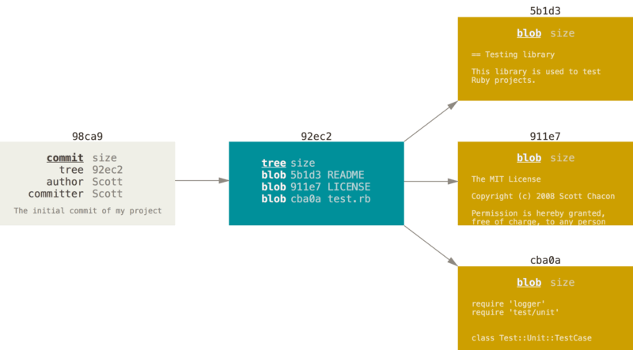
A commit and its tree

Slide 74
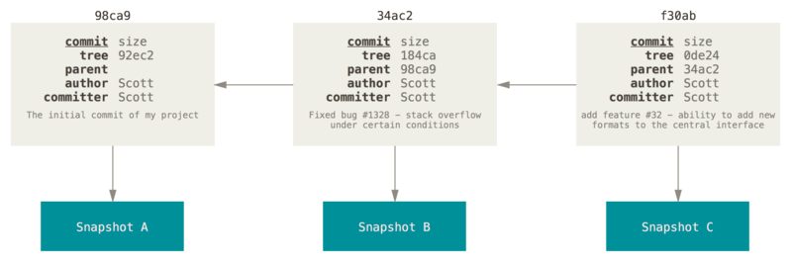
Commits and their parents
If you make some changes and commit again, the next commit stores a pointer to the commit that came immediately before it.

Slide 75
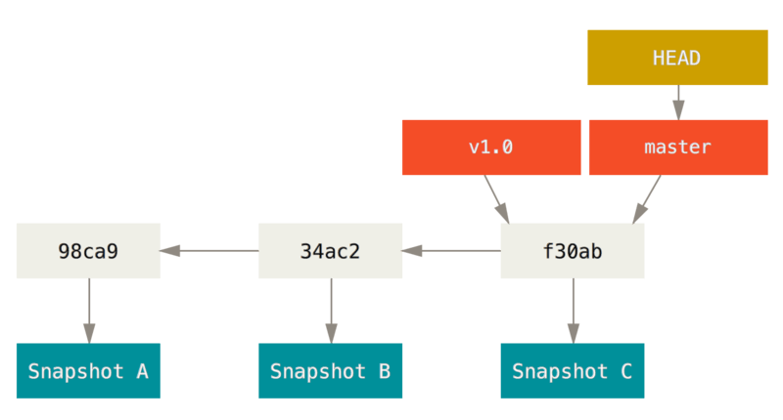
A branch and its commit history

Slide 76
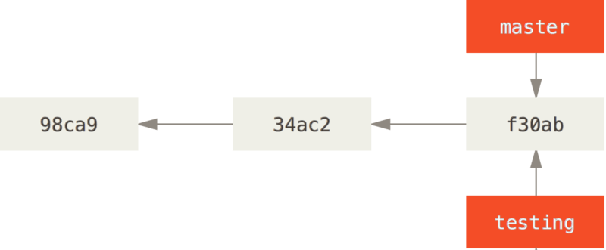
Creating a New Branch
What happens if you create a new branch? Well, doing so creates a new pointer for you to move around.
$ git branch testing.
This creates a new pointer to the same commit you’re currently on.

Slide 77
Some Commands
The git branch command does more than just create and delete branches. If you run it with no arguments, you get a simple listing of your current branches:
$ git branch
Notice the * character that prefixes the master branch: it indicates the branch that you currently have checked out (i.e., the branch that HEAD points to).
To see the last commit on each branch, you can run git branch -v:
$ git branch -v

Slide 78
Some commands
The useful --merged and --no-merged options can filter this list to branches that you have or have not yet merged into the branch you’re currently on.
To see which branches are already merged into the branch you’re on, you can run git branch --merged:
$ git branch –merged
To see all the branches that contain work you haven’t yet merged in, you can run git branch --no-merged:
$ git branch --no-merged
If you really do want to delete the branch and lose that work, you can force it with -D, as the helpful message points out.

Slide 79
Deleting branch
This shows your other branch. Because it contains work that isn’t merged in yet, trying to delete it with git branch -d will fail:
$ git branch -d testing
If you really do want to delete the branch and lose that work, you can force it with -D, as the helpful message points out.

Slide 80
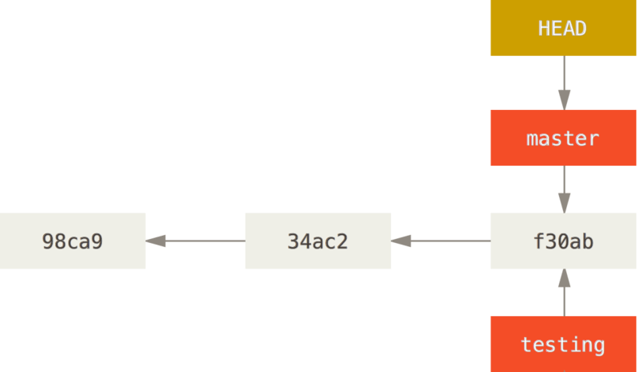
HEAD pointing to a branch
How does Git know what branch you’re currently on? It keeps a special pointer called HEAD.
You can easily see this by running a simple git log command that shows you where the branch pointers are pointing. This option is called --decorate.
$ git log --oneline --decorate

Slide 81
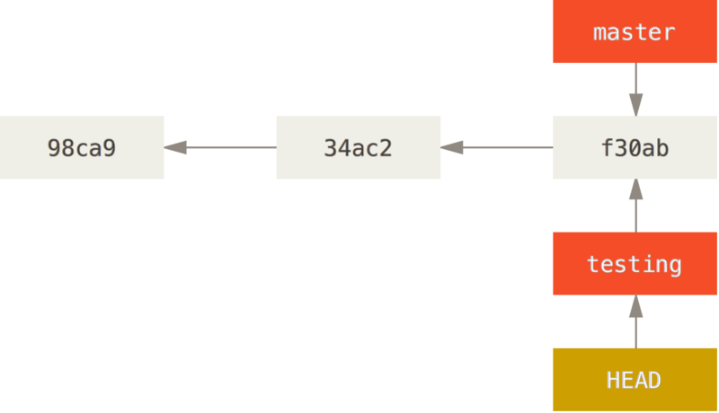
Switching Branches
To switch to an existing branch, you run the git checkout command. Let’s switch to the new testing branch:
$ git checkout testing → This moves HEAD to point to the testing branch.

Slide 82
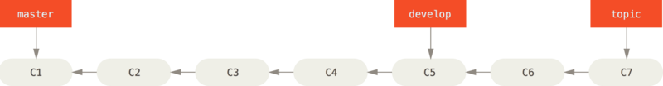
Branching Workflows 1.Long-Running Branches
Because Git uses a simple three-way merge, merging from one branch into another multiple times over a long period is generally easy to do.
This means you can have several branches that are always open and that you use for different stages of your development cycle; you can merge regularly from some of them into others.

Slide 83
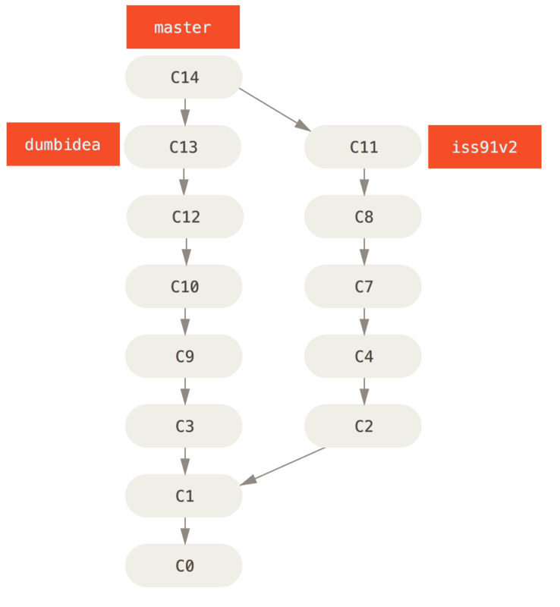
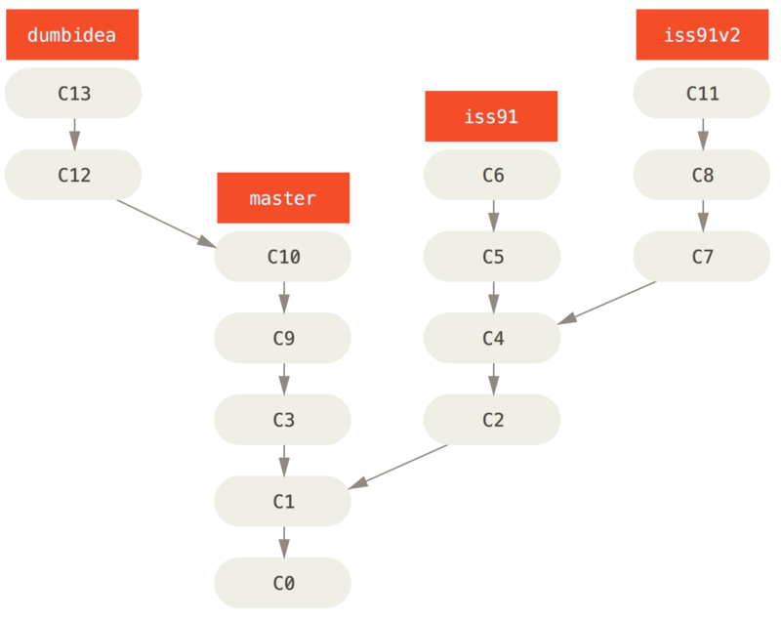
Branching Workflows Topic Branches

Slide 84
Basic Branching and Merging

Slide 85
Overvivew
Scenario
Basic Branching
Basic Merging
Basic Merge Conflicts

Slide 86
Basic Branching and Merging
Let’s go through a simple example of branching and merging with a workflow that you might use in the real world. You’ll follow these steps:
Do work on a web site.
Create a branch for a new story you’re working on.
Do some work in that branch.
At this stage, you’ll receive a call that another issue is critical and you need a hotfix. You’ll do the following:
Switch to your production branch.
Create a branch to add the hotfix.
After it’s tested, merge the hotfix branch, and push to production.
Switch back to your original story and continue working.

Slide 87
Basic Branching
This is an important point to remember: when you switch branches, Git resets your working directory to look like it did the last time you committed on that branch.
It adds, removes, and modifies files automatically to make sure your working copy is what the branch looked like on your last commit to it.

Slide 88
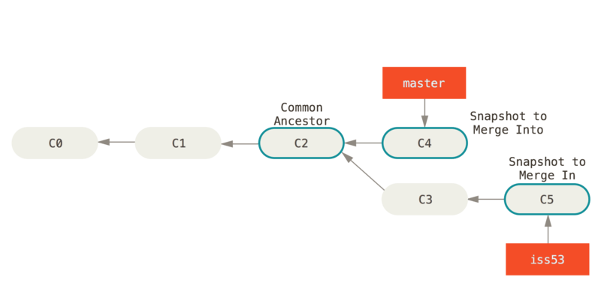
Basic Merging
Anything that has merge conflicts and hasn’t been resolved is listed as unmerged

Slide 89
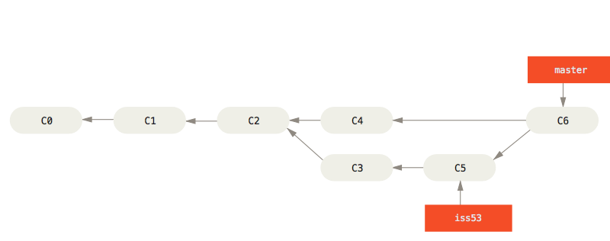
Basic Merging

Slide 90
Basic Merge Conflicts
Anything that has merge conflicts and hasn’t been resolved is listed as unmerged.
Git adds standard conflict-resolution markers to the files that have conflicts, so you can open them manually and resolve those conflicts.
This resolution has a little of each section, and the <<<<<<<, =======, and >>>>>>> lines have been completely removed.
If you want to use a graphical tool to resolve these issues, you can run git mergetool, which fires up an appropriate visual merge tool and walks you through the conflicts: $git mergetool
You need config merge tool by command:
$ git config --global merge.tool

Slide 91
Remote Branches

Slide 92
Remote Branches
Remote references are references (pointers) in your remote repositories, including branches, tags, and so on.
You can get a full list of remote references explicitly with
$git ls-remote [remote], or $git remote show [remote] for remote branches as well as more information.

Slide 93
Note
Just like the branch name “master” does not have any special meaning in Git, neither does “origin”.
While “master” is the default name for a starting branch when you run $git init which is the only reason it’s widely used,
“origin” is the default name for a remote when you run git clone.
If you run $git clone -o tedu instead, then you will have tedu/master as your default remote branch.

Slide 94
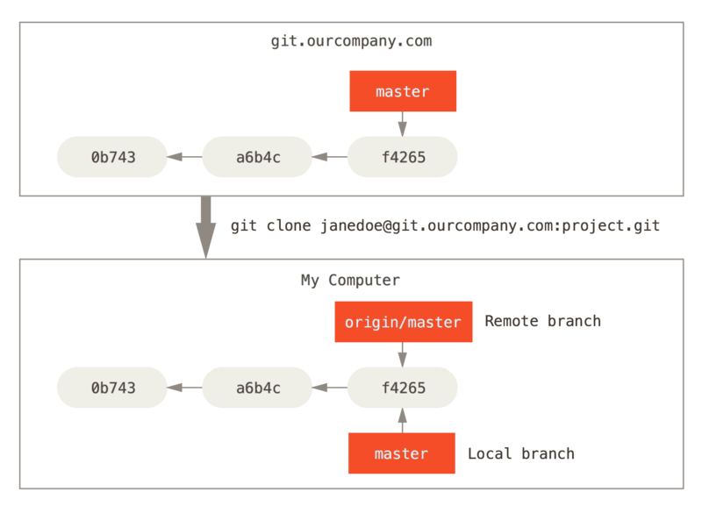
Server and local repositories after cloning

Slide 95
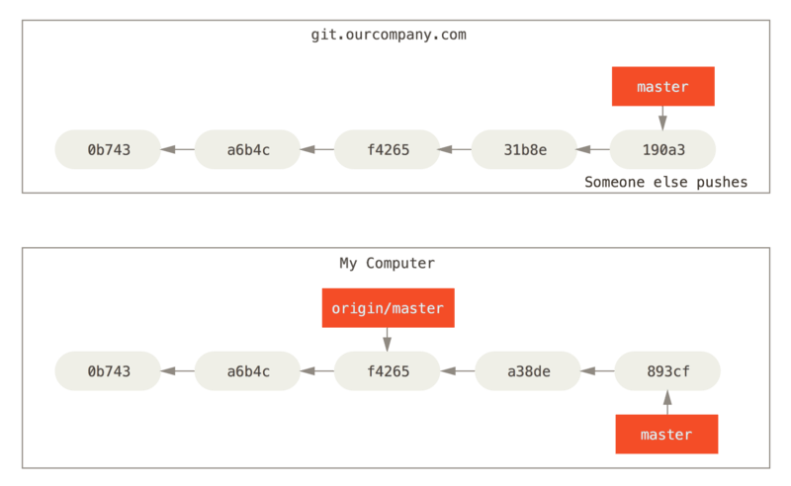
Local and remote work can diverge
To synchronize your work, you run a git fetch origin command.

Slide 96
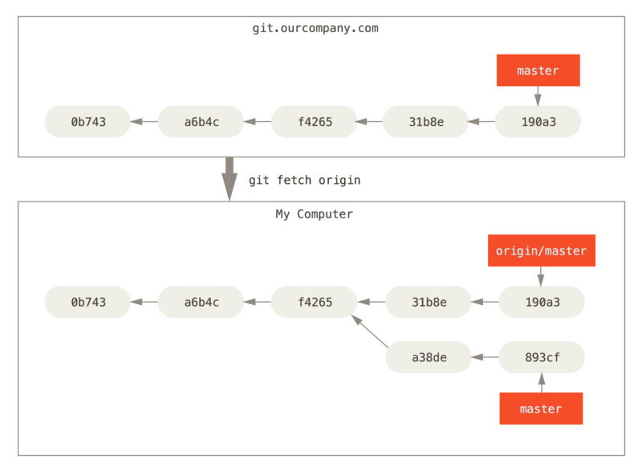
git fetch updates your remote references

Slide 97
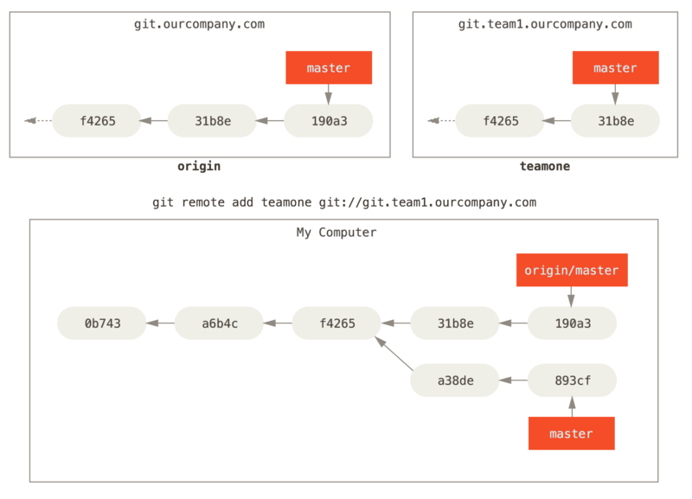
Adding another server as a remote

Slide 98
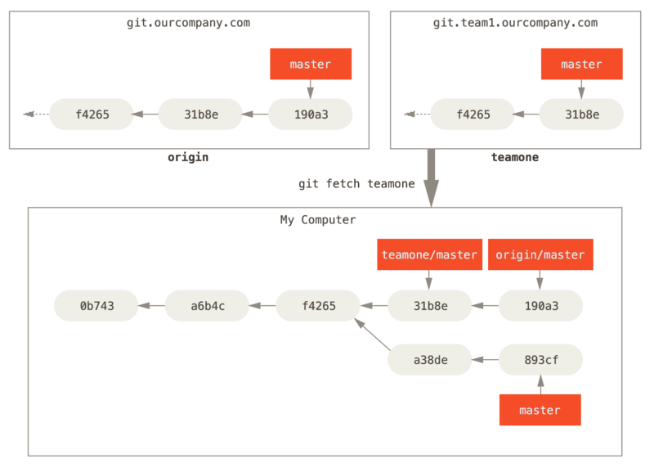
Remote tracking branch for teamone/master

Slide 99
Pushing
When you want to share a branch with the world, you need to push it up to a remote that you have write access to.
Your local branches aren’t automatically synchronized to the remotes you write to – you have to explicitly push the branches you want to share.
That way, you can use private branches for work you don’t want to share, and push up only the topic branches you want to collaborate on.
Syntax: $ git push origin branch_name

Slide 100
Don’t type your password every time
If you’re using an HTTPS URL to push over, the Git server will ask you for your username and password for authentication.
By default it will prompt you on the terminal for this information so the server can tell if you’re allowed to push.
If you don’t want to type it every single time you push, you can set up a “credential cache”. The simplest is just to keep it in memory for a few minutes, which you can easily set up by running:
$git config --global credential.helper cache.

Slide 101
Checkout remote branches
If you want your own serverfix branch that you can work on, you can base it off your remote-tracking branch:
$ git checkout -b serverfix origin/serverfix
This gives you a local branch that you can work on that starts where origin/serverfix is.

Slide 102
Tracking Branches
Checking out a local branch from a remote-tracking branch automatically creates what is called a “tracking branch” (and the branch it tracks is called an “upstream branch”).
$git checkout -b [branch] [remotename]/[branch] or $ git checkout --track origin/serverfix
To set up a local branch with a different name than the remote branch:
$ git checkout -b sf origin/serverfix
If you already have a local branch and want to set it to a remote branch you just pulled down, or want to change the upstream branch you’re tracking.
$ git branch -u origin/serverfix
If you want to see what tracking branches you have set up,
$ git branch -vv

Slide 103
Pulling
There is a command called git pull which is essentially a git fetch immediately followed by a git merge in most cases.

Slide 104
Deleting Remote Branches
Suppose you’re done with a remote branch – say you and your collaborators are finished with a feature and have merged it into your remote’s master branch (or whatever branch your stable codeline is in).
You can delete a remote branch using the --delete option to git push. If you want to delete your serverfix branch from the server, you run the following:
$ git push origin --delete serverfix
Basically all this does is remove the pointer from the server. The Git server will generally keep the data there for a while until a garbage collection runs, so if it was accidentally deleted, it’s often easy to recover.

Slide 105
Rebasing

Slide 106
Overview
The Basic Rebase
More Interesting Rebases
Rebase When You Rebase
Rebase vs. Merge

Slide 107
Rebasing
In Git, there are two main ways to integrate changes from one branch into another: the merge and the rebase.
In this section you’ll learn what rebasing is, how to do it, why it’s a pretty amazing tool, and in what cases you won’t want to use it.

Slide 108
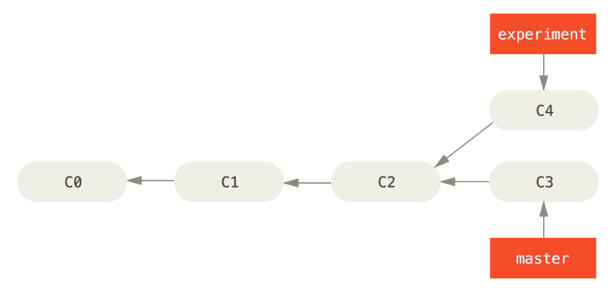
The Basic Rebase
Simple divergent history

Slide 109
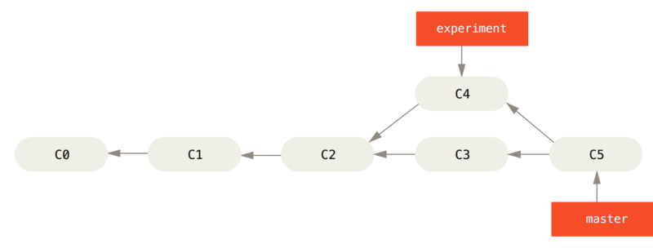
The Basic Rebase
Merging to integrate diverged work history

Slide 110
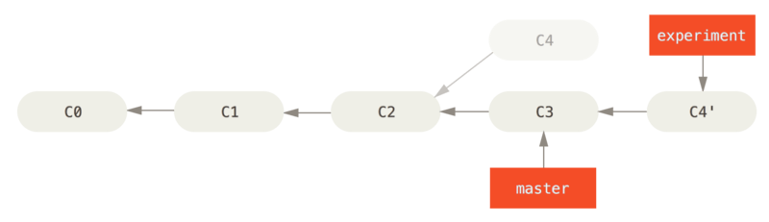
The Basic Rebase
Rebasing the change introduced in C4 onto C3

Slide 111
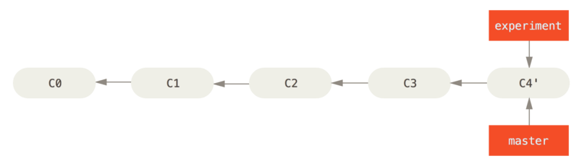
The Basic Rebase
Fast-forwarding the master branch
$ git checkout master
$ git merge experiment

Slide 112
More Interesting Rebases
You can also have your rebase replay on something other than the rebase target branch.
You branched a topic branch (server) to add some server-side functionality to your project, and made a commit.
Then, you branched off that to make the client-side changes (client) and committed a few times.
Finally, you went back to your server branch and did a few more commits.

Slide 113
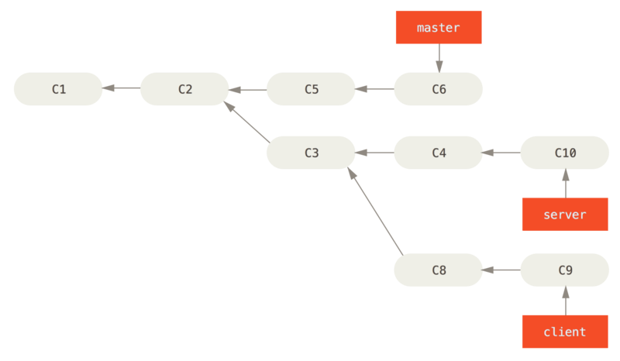
More Interesting Rebases - 2

Slide 114
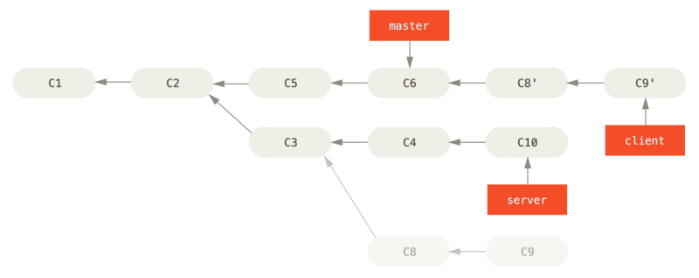
More Interesting Rebases - 3
$ git rebase --onto master server client

Slide 115
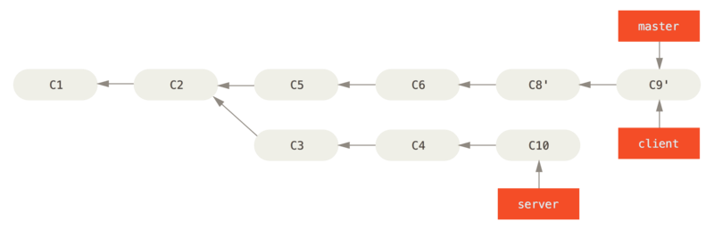
More Interesting Rebases - 4
$ git checkout master
$ git merge client

Slide 116
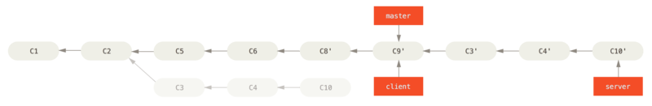
More Interesting Rebases - 5
$ git rebase master server
$ git checkout master
$ git merge server

Slide 117
The Perils of Rebasing
Do not rebase commits that exist outside your repository.
When you rebase stuff, you’re abandoning existing commits and creating new ones that are similar but different.
If you push commits somewhere and others pull them down and base work on them, and then you rewrite those commits with git rebase and push them up again, your collaborators will have to re-merge their work and things will get messy when you try to pull their work back into yours.

Slide 118
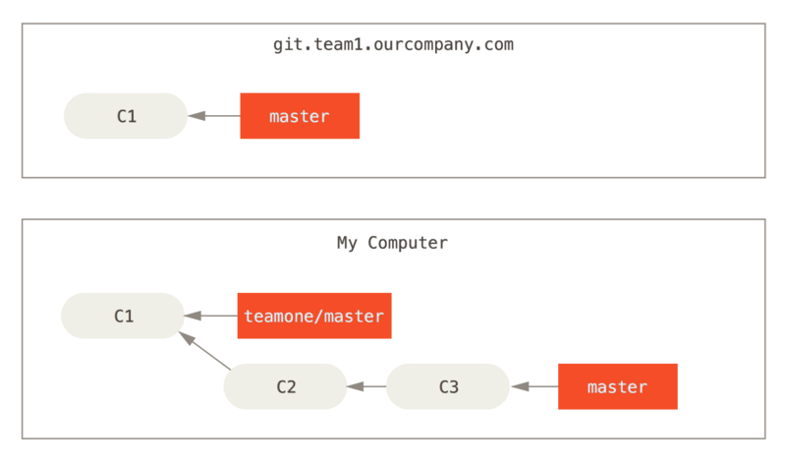
The Perils of Rebasing
Clone a repository, and base some work on it

Slide 119
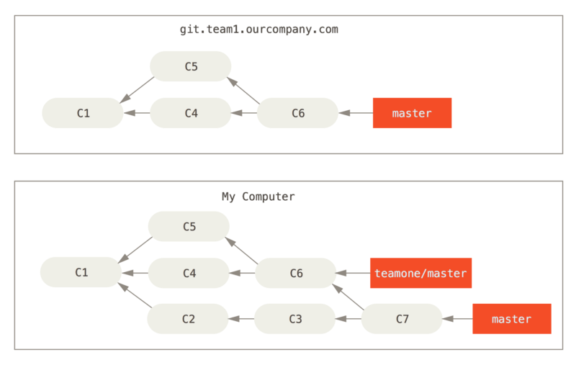
The Perils of Rebasing
Fetch more commits, and merge them into your work

Slide 120
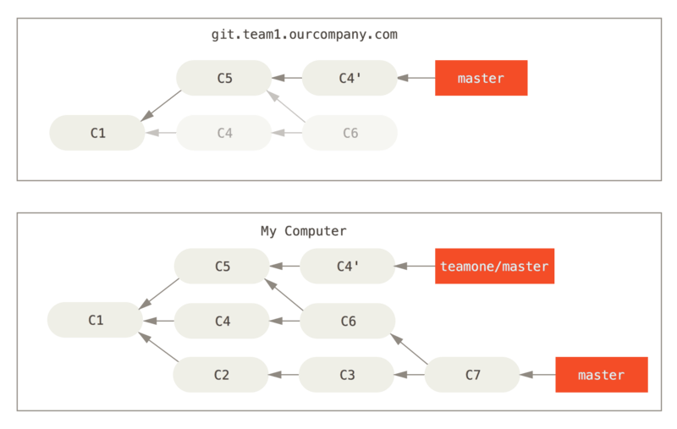
The Perils of Rebasing
Someone pushes rebased commits, abandoning commits you’ve based your work on

Slide 121
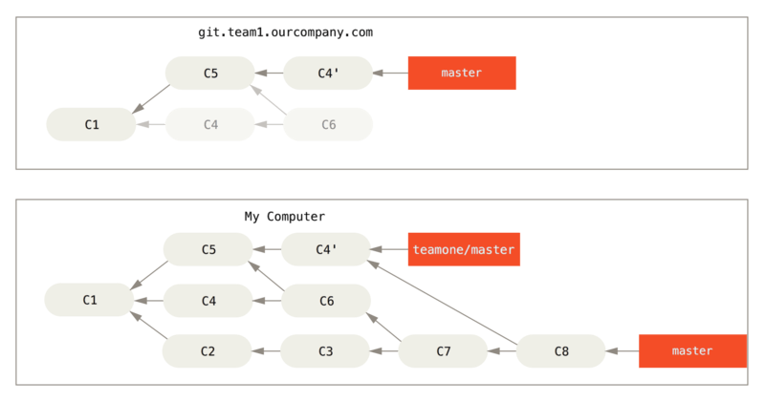
The Perils of Rebasing
You merge in the same work again into a new merge commit

Slide 122
Rebase When You Rebase
If someone on your team force pushes changes that overwrite work that you’ve based work on, your challenge is to figure out what is yours and what they’ve rewritten.
You can also simplify this by running a git pull --rebase instead of a normal git pull. Or you could do it manually with a git fetch followed by a git rebase teamone/master in this case.
If you are using git pull and want to make --rebase the default, you can set the pull.rebase config value with something like
$git config --global pull.rebase true.

Slide 123
Rebase vs. Merge
Git is a powerful tool, and allows you to do many things to and with your history, but every team and every project is different.
Now that you know how both of these things work, it’s up to you to decide which one is best for your particular situation.
In general the way to get the best of both worlds is to rebase local changes you’ve made but haven’t shared yet before you push them in order to clean up your story, but never rebase anything you’ve pushed somewhere.

Slide 124
Summary
We’ve covered basic branching and merging in Git.
You should feel comfortable creating and switching to new branches, switching between branches and merging local branches together.
You should also be able to share your branches by pushing them to a shared server, working with others on shared branches and rebasing your branches before they are shared.
Next, we’ll cover what you’ll need to run your own Git repository-hosting server.

Slide 125
Reset Demystified

Slide 126
Reset Demystified
Before moving on to more specialized tools, let’s talk about reset and checkout.
These commands are two of the most confusing parts of Git when you first encounter them.
They do so many things, that it seems hopeless to actually understand them and employ them properly.

Slide 127
The Three Trees
An easier way to think about reset and checkout is through the mental frame of Git being a content manager of three different trees.
By “tree” here we really mean “collection of files”, not specifically the data structure.
Git as a system manages and manipulates three trees in its normal operation:
Tree | Role
HEAD | Last commit snapshot, next parent
Index | Proposed next commit snapshot
Working Directory | Sandbox

Slide 128
The HEAD
HEAD is the pointer to the current branch reference, which is in turn a pointer to the last commit made on that branch.
That means HEAD will be the parent of the next commit that is created. It’s generally simplest to think of HEAD as the snapshot of your last commit.

Slide 129
The Index
The Index is your proposed next commit.
We’ve also been referring to this concept as Git’s “Staging Area” as this is what Git looks at when you run git commit.
$ git ls-files -s

Slide 130
The Working Directory
Finally, you have your working directory. The other two trees store their content in an efficient but inconvenient manner, inside the .git folder.
The Working Directory unpacks them into actual files, which makes it much easier for you to edit them.
Think of the Working Directory as a sandbox, where you can try changes out before committing them to your staging area (index) and then to history.

Slide 131
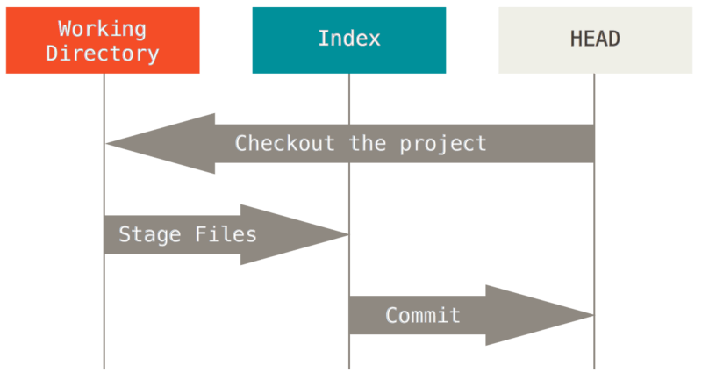
The Workflow Processed
Git’s main purpose is to record snapshots of your project in successively better states, by manipulating these three trees.

Slide 132
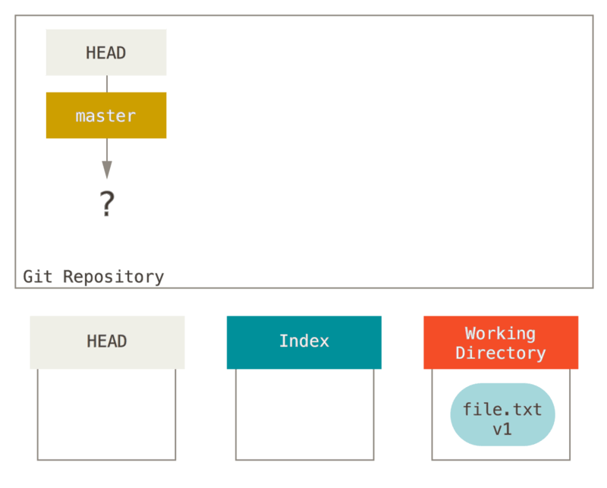
The Workflow - Init
Now we run git init, which will create a Git repository with a HEAD reference which points to an unborn branch (master doesn’t exist yet).

Slide 133
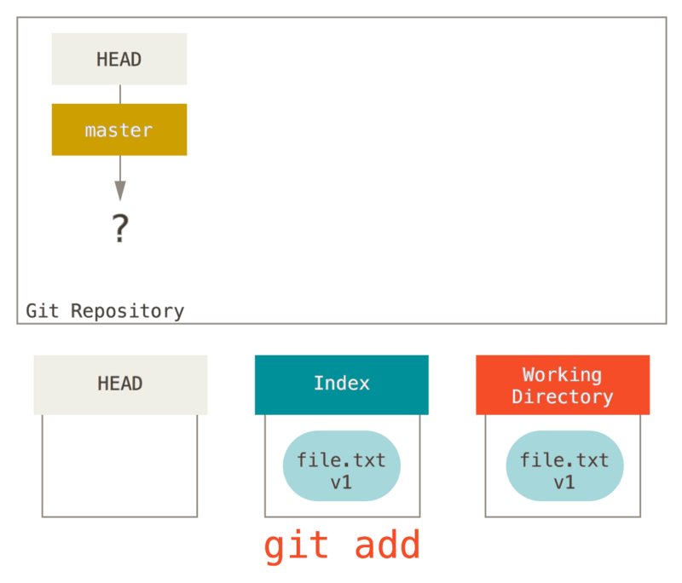
The Workflow – Add file
Now we want to commit this file, so we use git add to take content in the Working Directory
and copy it to the Index.

Slide 134
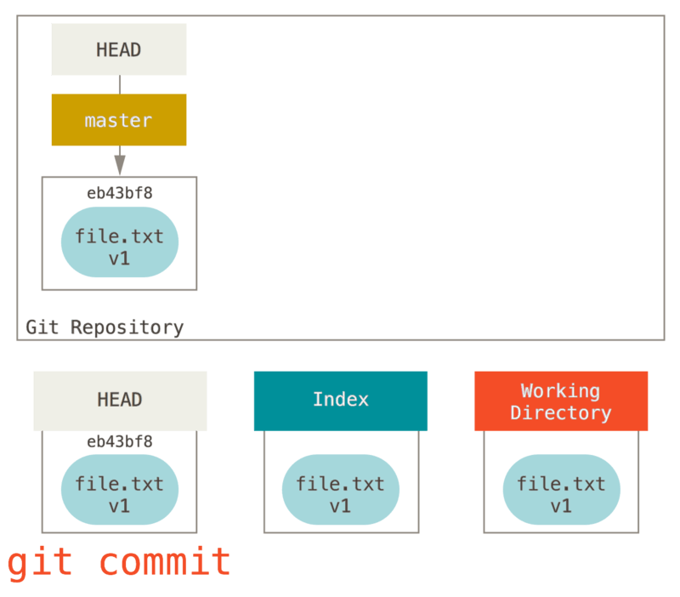
The Workflow - Commit
Then we run git commit, which takes the contents of the Index and saves it as a permanent snapshot, creates a commit object which points to that snapshot, and updates master to point to that commit.

Slide 135
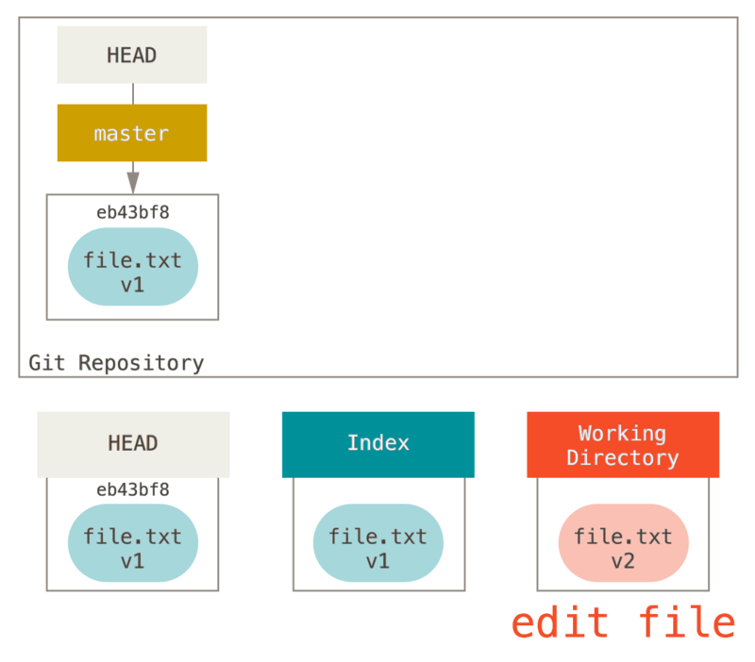
The Workflow – Edit existed file

Slide 136
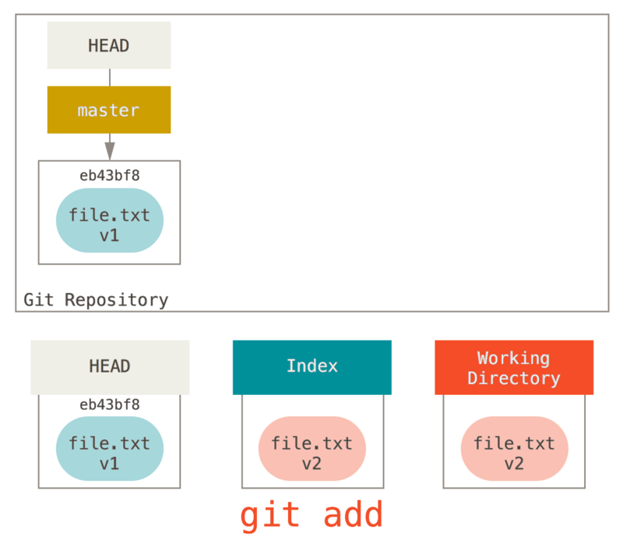
The Workflow – Staged Files

Slide 137
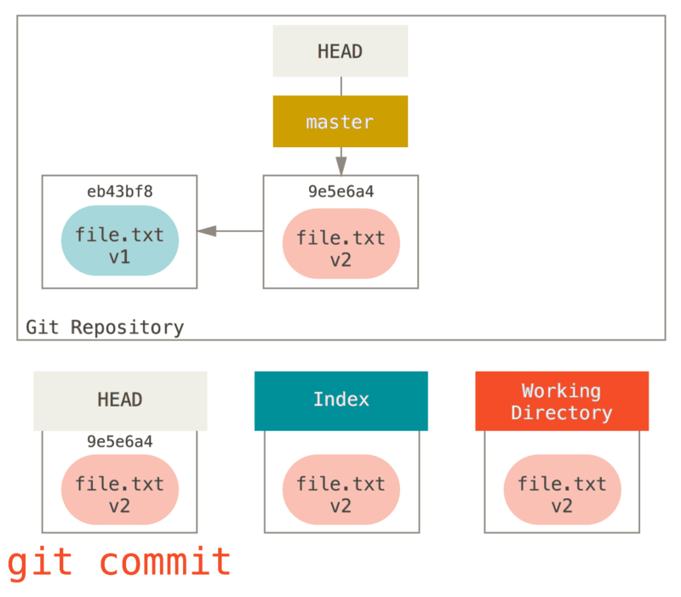
The Workflow – Commit modified

Slide 138
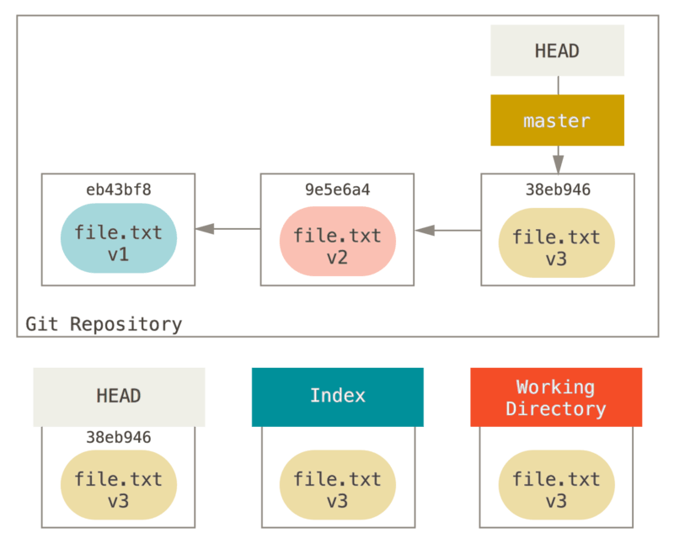
The Role of Reset

Slide 139
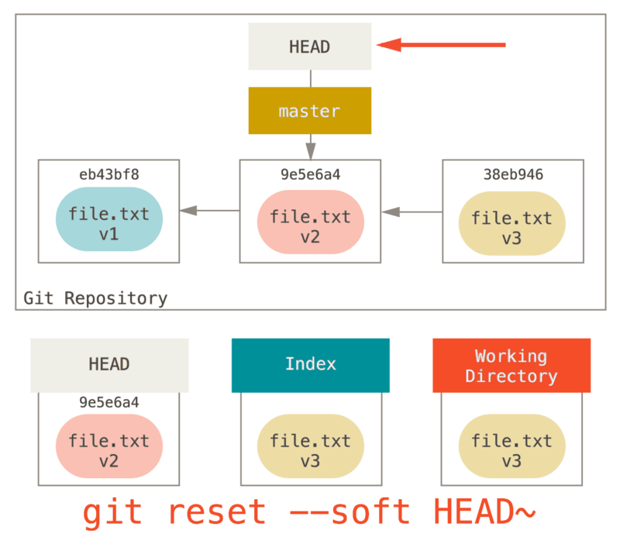
Step 1: Move HEAD
Running git reset 9e5e6a4 will start by making master point to 9e5e6a4

Slide 140
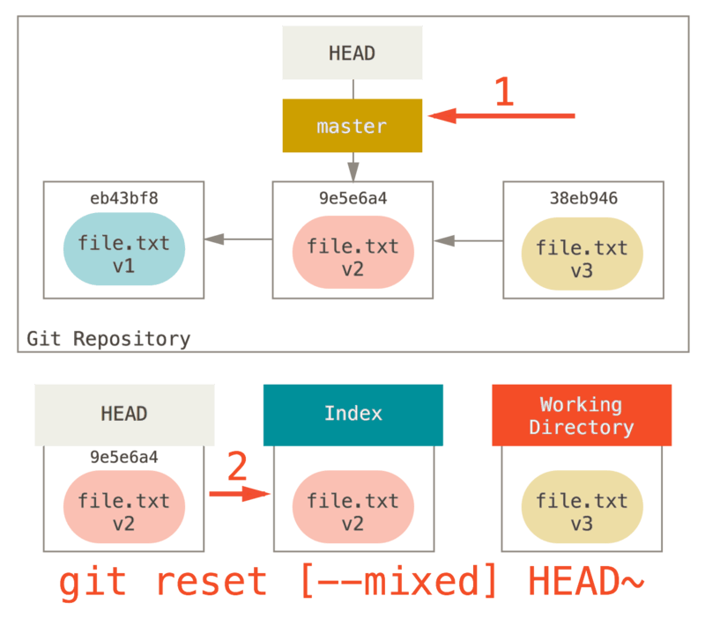
Step 2: Updating the Index (--mixed)

Slide 141
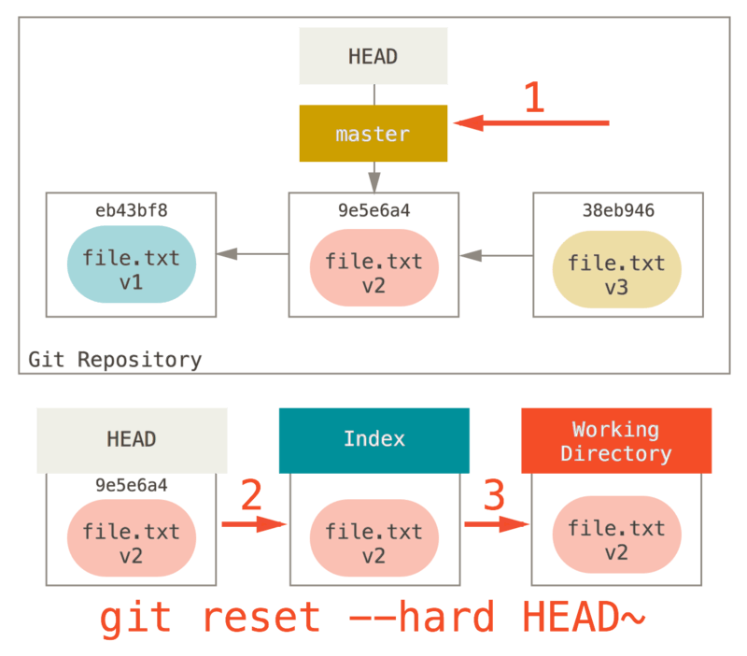
Step 3: Updating the Working Directory (--hard)

Slide 142
Recap
The reset command overwrites these three trees in a specific order, stopping when you tell it to:
Move the branch HEAD points to (stop here if --soft)
Make the Index look like HEAD (stop here unless --hard)
Make the Working Directory look like the Index

Slide 143
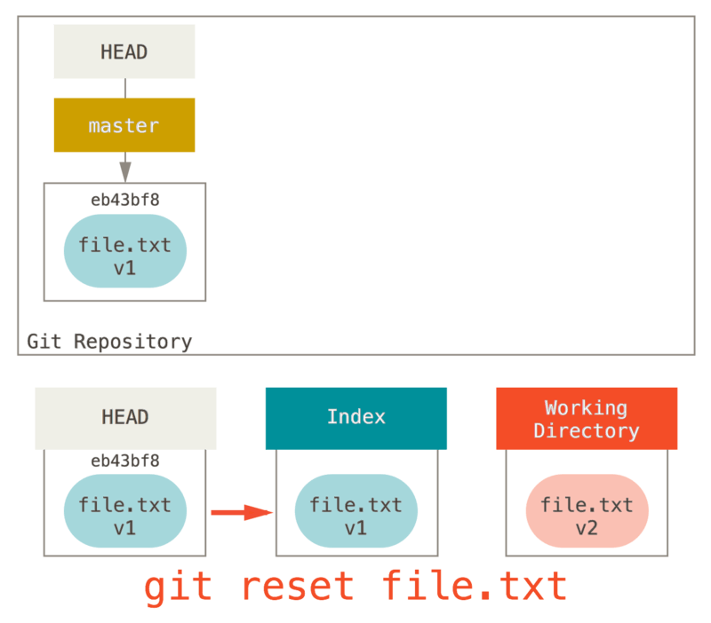
Reset With a Path
So, assume we run git reset file.txt. This form (since you did not specify a commit SHA-1 or branch, and you didn’t specify --soft or --hard) is shorthand for git reset --mixed HEAD file.txt, which will:
Move the branch HEAD points to (skipped)
Make the Index look like HEAD (stop here)
So it essentially just copies file.txt from HEAD to the Index.

Slide 144
Check It Out
Finally, you may wonder what the difference between checkout and reset is. Like reset, checkout manipulates the three trees, and it is a bit different depending on whether you give the command a file path or not.
First, unlike reset --hard, checkout is working-directory safe; it will check to make sure it’s not blowing away files that have changes to them.
The second important difference is how it updates HEAD. Where reset will move the branch that HEAD points to, checkout will move HEAD itself to point to another branch.

Slide 145
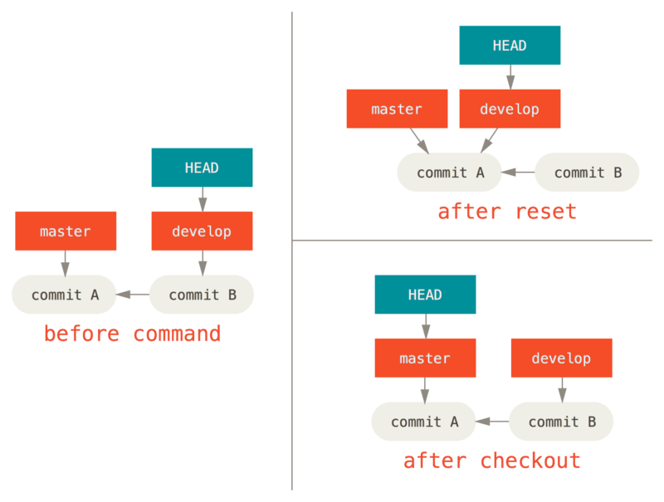
Check It Out

Slide 146
Summary
Here’s a cheat-sheet for which commands affect which trees.
The “HEAD” column reads “REF” if that command moves the reference (branch) that HEAD points to, and “HEAD” if it moves HEAD itself.
Pay especial attention to the WD Safe? column – if it says NO, take a second to think before running that command.
 | HEAD | Index | Workdir | WD Safe?
Commit Level
reset --soft [commit] | REF | NO | NO | YES
reset [commit] | REF | YES | NO | YES
reset --hard [commit] | REF | YES | YES | NO
checkout [commit] | HEAD | YES | YES | YES
File Level
reset (commit) [file] | NO | YES | NO | YES
checkout (commit) [file] | NO | YES | YES | NO

Slide 147
Git Tools - Stashing and Cleaning
Trainer: Bach Ngoc Toan – TEDU Founder
Support Forum: http://forum.tedu.com.vn

Slide 148
Stashing and Cleaning
Often, when you’ve been working on part of your project, things are in a messy state and you want to switch branches for a bit to work on something else.
The problem is, you don’t want to do a commit of half-done work just so you can get back to this point later.
The answer to this issue is the git stash command.
Stashing takes the dirty state of your working directory – that is, your modified tracked files and staged changes – and saves it on a stack of unfinished changes that you can reapply at any time.

Slide 149
Stashing Your Work
To demonstrate, you’ll go into your project and start working on a couple of files and possibly stage one of the changes. If you run git status, you can see your dirty state.
Now you want to switch branches, but you don’t want to commit what you’ve been working on yet; so you’ll stash the changes.
To push a new stash onto your stack, run git stash or git stash save.
At this point, you can easily switch branches and do work elsewhere; your changes are stored on your stack. To see which stashes you’ve stored, you can use:
$git stash list.
If you want to apply one of the older stashes, you can specify it by naming it, like this:
$git stash apply stash@{2}.
If you don’t specify a stash, Git assumes the most recent stash and tries to apply it:
$ git stash apply

Slide 150
Stashing Your Work
The changes to your files were reapplied, but the file you staged before wasn’t restaged. To do that, you must run the git stash apply command with a --index option to tell the command to try to reapply the staged changes.
$ git stash apply –index
To remove it, you can run git stash drop with the name of the stash to remove:
$ git stash drop stash@{0}
You can also run git stash pop to apply the stash and then immediately drop it from your stack.

Slide 151
Creative Stashing
There are a few stash variants that may also be helpful. The first option that is quite popular is the --keep-index option to the stash save command. This tells Git to not stash anything that you’ve already staged with the git add command.
Another common thing you may want to do with stash is to stash the untracked files as well as the tracked ones. By default, git stash will only store files that are already in the index. If you specify --include-untracked or -u, Git will also stash any untracked files you have created.
Finally, if you specify the --patch flag, Git will not stash everything that is modified but will instead prompt you interactively which of the changes you would like to stash and which you would like to keep in your working directory.

Slide 152
Creating a Branch from a Stash
If you stash some work, leave it there for a while, and continue on the branch from which you stashed the work, you may have a problem reapplying the work.
If the apply tries to modify a file that you’ve since modified, you’ll get a merge conflict and will have to try to resolve it.
If you want an easier way to test the stashed changes again, you can run $git stash branch, which creates a new branch for you, checks out the commit you were on when you stashed your work, reapplies your work there, and then drops the stash if it applies successfully.

Slide 153
Cleaning your Working Directory
Finally, you may not want to stash some work or files in your working directory, but simply get rid of them. The git clean command will do this for you.
A safer option is to run git stash --all to remove everything but save it in a stash.
To remove all the untracked files in your working directory, you can run
$git clean -f -d, which removes any files and also any subdirectories that become empty as a result.
If you ever want to see what it would do, you can run the command with the -n option, which means “do a dry run and tell me what you would have removed”.

Slide 154
Cleaning your Working Directory
By default, the $git clean command will only remove untracked files that are not ignored.
Any file that matches a pattern in your .gitignore or other ignore files will not be removed.
If you want to remove those files too, such as to remove all .o files generated from a build so you can do a fully clean build, you can add a -x to the clean command.

